Slide 1
Machine Learning
Gradient Descent Algorithm
Linear Regression
Non-Linear Regression
Logistic Regression
Decision Trees
Regression Trees
Classification Trees
Model complexity and ensemble models
Clustering Algorithms
K-Means
Hierarchical clustering
DB-Scan
Mean Shift
GMM
Support Vector Machine
Datasets
Breast Cancer Wisconsin
MIMIC-III
Framingham Heart Study
Alzheimer’s Disease Neuroimaging Initiative
Drug discovery
Microbiome
Deep Learning
MLP
CNN
CNN Arquitectures
Autoencoders
E: Transfer learning y fine tunning
Recurrent Neural Networks
VAE
GAN
Transformers
Diffusion Models
Paper + Implementation

Slide 2
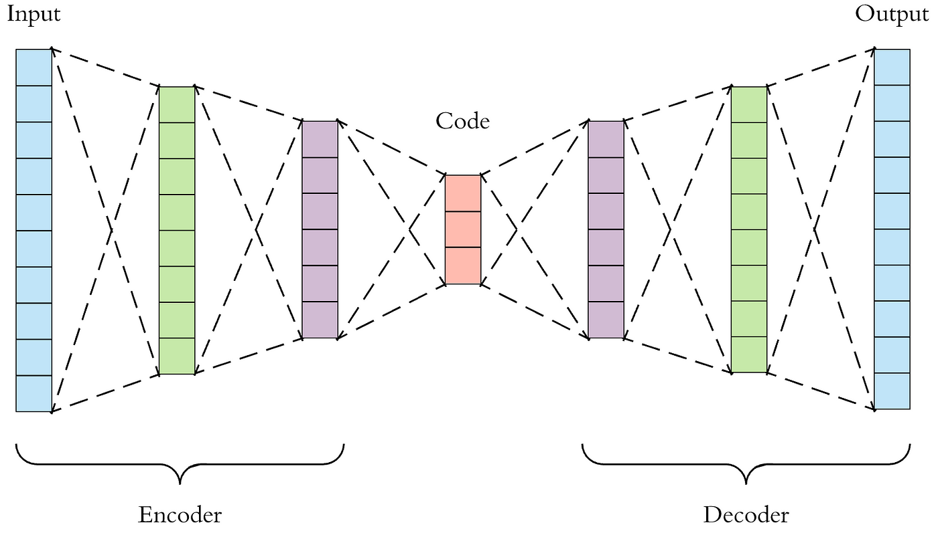
C14 – CNN architectures semantic segmentation
my humble ML course

Slide 3
my humble ML course
U-Net

Slide 4
my humble ML course
SegNet

Slide 5
my humble ML course
E-Net

Slide 6
my humble ML course
PSP-Net

Slide 7
my humble ML course
ESP-Net

Slide 8
my humble ML course
SegViT

Slide 9
my humble ML course
Bibliography
https://arxiv.org/pdf/2305.03273.pdf

